Slide 1


Probabilistic Sequential Consistency in Social Networks
Presented by: Priyanka Singla
Shubhankar Suman Singh
Prof. Smruti R. Sarangi
(IIT-Delhi)
Prof. K. Gopinath
(IISc)

Slide 2



Overloading

Slide 3
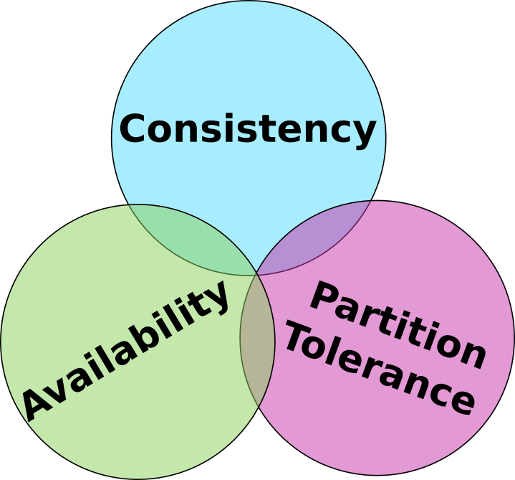
Does no partitioning guarantee assure CA?
System Overloading?
Brewer’s CAP theorem
3

Slide 4
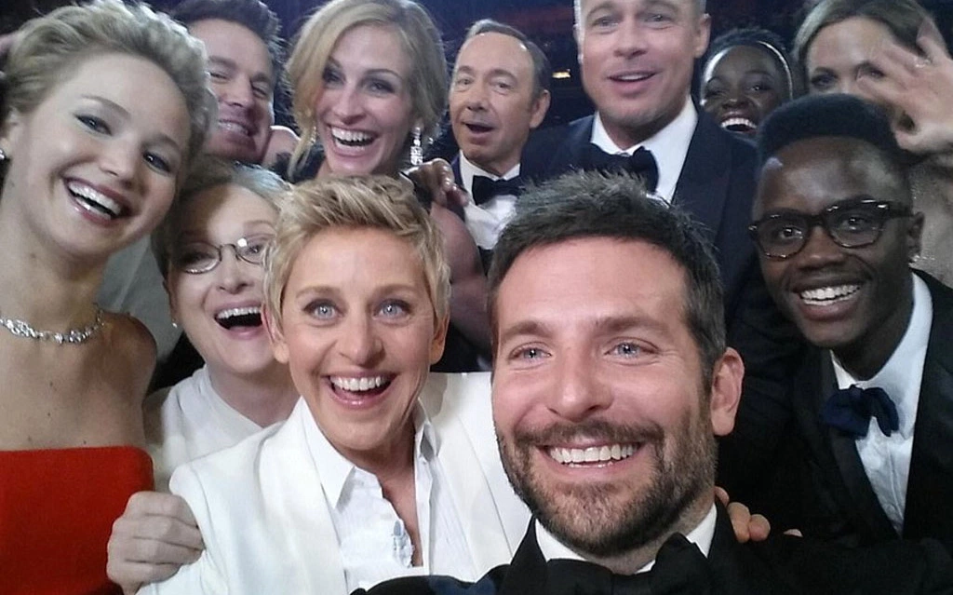

Ellen DeGeneres’ Famous 2014 Oscar Selfie.
Something is technically wrong. Thanks for noticing-we’re going to fix it up and have things back to normal soon.
3,283,353 retweets.
4

Slide 5
Existing Solutions
Existing Solutions
Overloading

Slide 6
Data and metadata partitioning [LM, WBMP].
Entire system overload.
Performance deterioration when accesses are skewed.
Single object overload.
Relaxed Consistency Models
Red-Blue consistency [LPCGPR].
CRDTs : Conflict-free Replicated Data Types [SPBZ].
Prioritize some operations. (Amazon)
Operation dependent.
Trades off availability.
Trades off consistency or availability.
Existing solutions
Replication and caching [W, LPCGPR].
Read dominating workloads.
Trades off performance or consistency for write dominated.
Admission control and load balancing [ENTZ, RLB].
Favor some clients.
Drop non-critical requests.
Cannot satisfy all clients.
Trades off consistency or availability.
6

Slide 7
Data and metadata partitioning
Relaxed consistency models
Cannot satisfy all the clients.
Unable to handle write dominated, single object overloads.
Operation dependent.
Existing solutions
Replication and caching
Admission control and load balancing
7

Slide 8
Existing Solutions
Social Consistency
Existing Solutions
Overloading

Slide 9
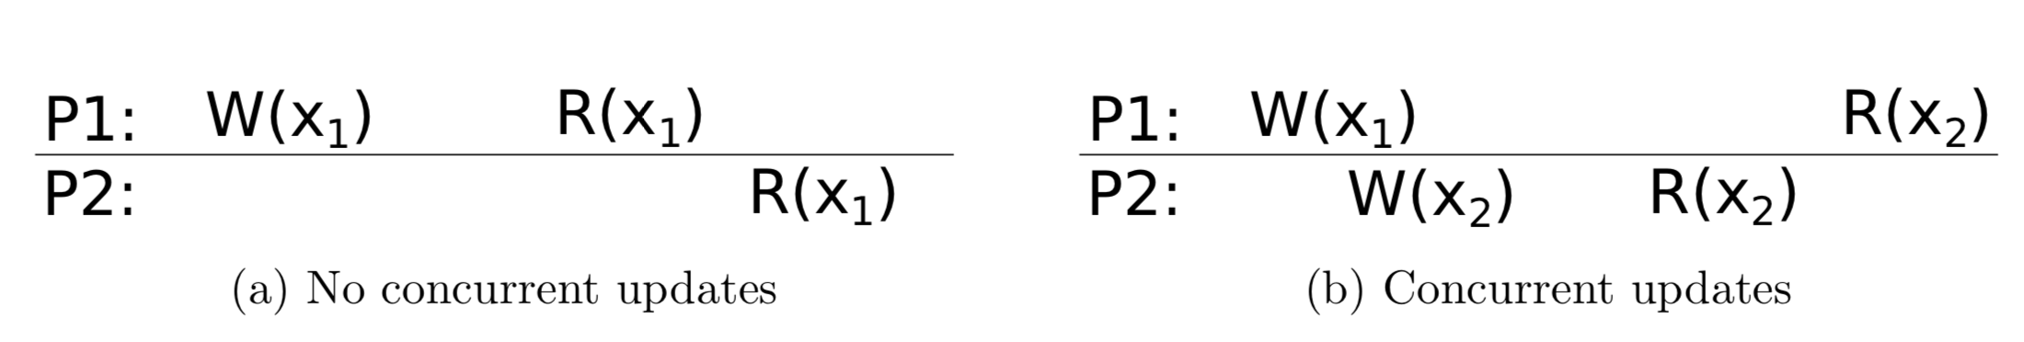
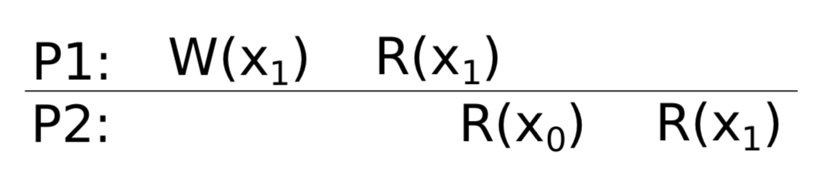
If no new updates, eventually all reads will return the last updated value.
Once an update completes, subsequent accesses return the same value.
-Slow Reads/Writes.
-Poor quality of response.
Consistency Spectrum
Strong Eventual
+User Satisfaction.
+No Violations.
+Good performance, low latency.
Can we have the best of both worlds?
9

Slide 10

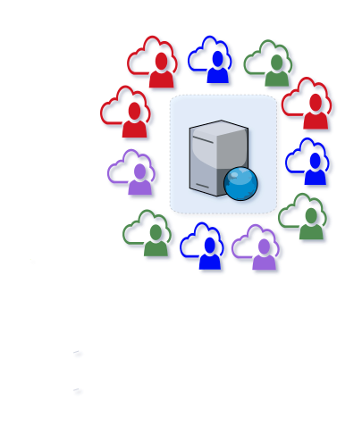
8
6
2
8
6
9
9
9
8
9
8
9
9
9
1
9
8
8
1
3
8
9
9
8
5
5
7
9
1
7
9
9
9
9
9
10

Slide 11

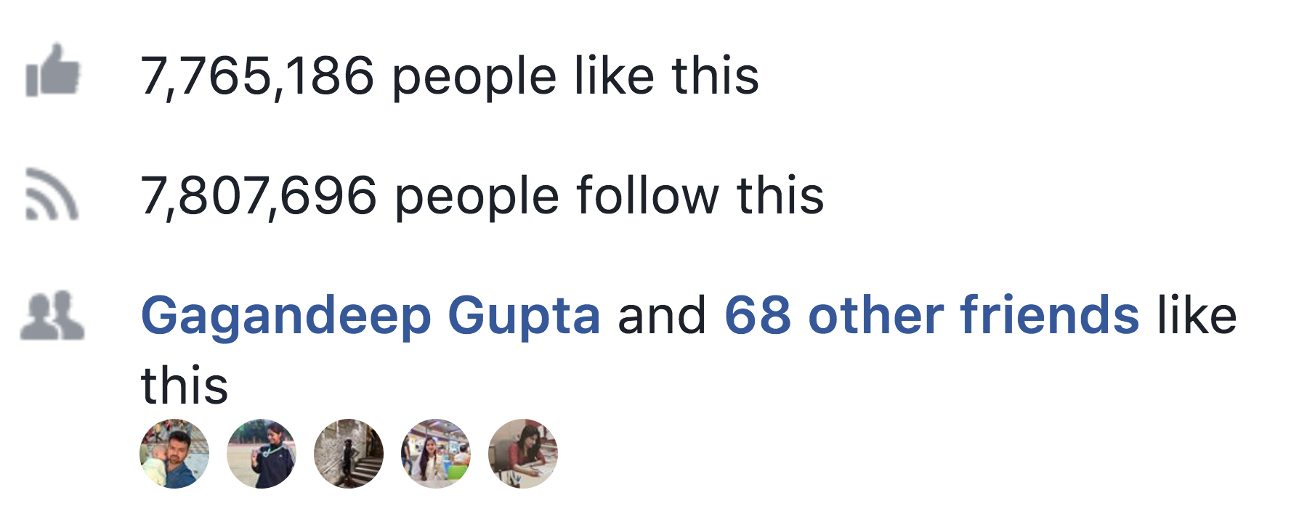
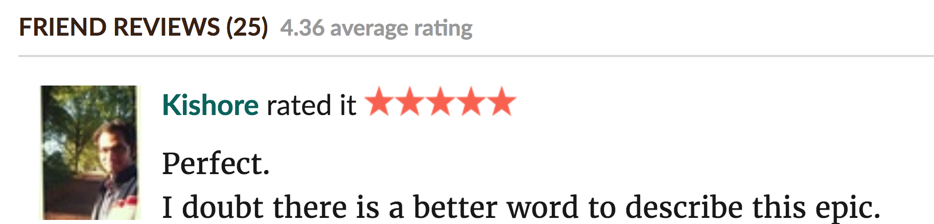
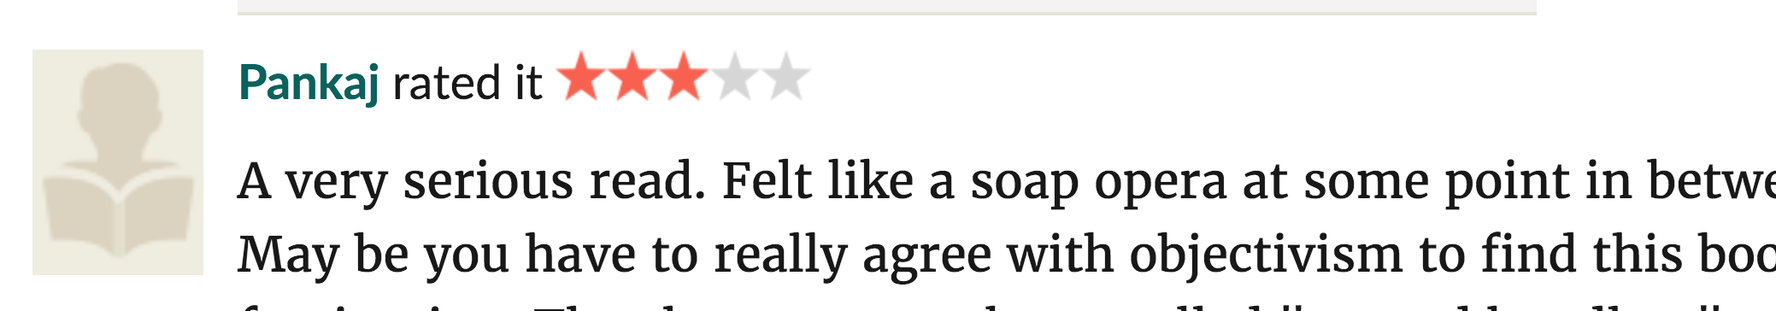




For all practical purposes, users mostly interact with other users socially connected to them.
Why Social Networks?
11

Slide 12
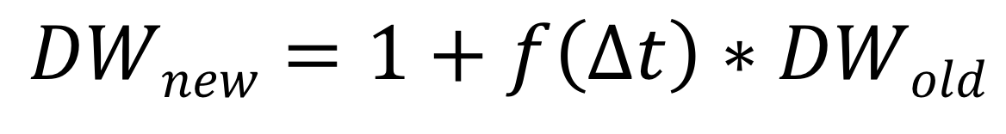
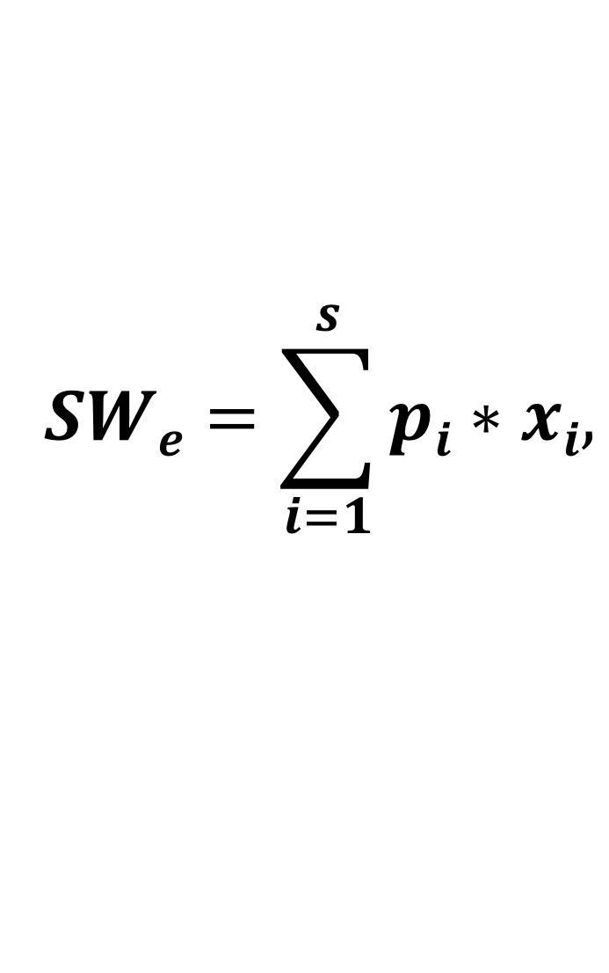
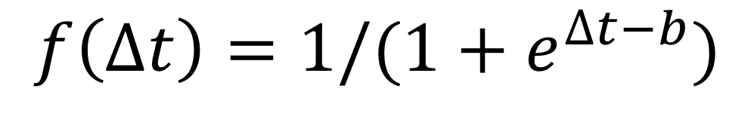
Weighted Graph G(C,E)
Captures the contribution of each client in overload
Damping Function
Priority
Captures client-client interaction.
Feature
$$SWe=\sum_{i=1}^{s}{pi∗xi,}$$
Node Weights
Minimize loss in social connectivity.
Maximize load balancing.
Edge Weights
$$DWnew=1+f\left(∆t\right)∗DWold$$
$$f\left(∆t\right)=1/(1+e^{∆t−b})$$
Static
Per-object Dynamic
Dynamic
12

Slide 13

Violations as a Tuning knob
Violations
Performance
Quality
13

Slide 14
Theoretical Model
Social Consistency
Existing Solutions
Overloading

Slide 15





System Model
p
Each sub-domain is sequentially consistent.
p
Happens-before relationship
1-p
(x)
p
(x+1)
Linear Order
1-p
Intra-Cluster Communication

Slide 16
System Model
Random Walk
p
R
(x’,y’)
Each sub-domain is sequentially consistent.
p
1 - p
D=N(μ,𝞼²)
1-p
(x,y)
p
(x+1,y)
Linear Order
Inter-Cluster Communication
1-p

Slide 17
SC Violation
Frontier(y) = Max { x: State(x,y) = visited }
4
4
1-p
1-p
V
F
p
2
3
3
1-p
Read or Write, happens before relation.
p
(x,y)
5
1
1
Violation
Each cluster’s progress

Slide 18
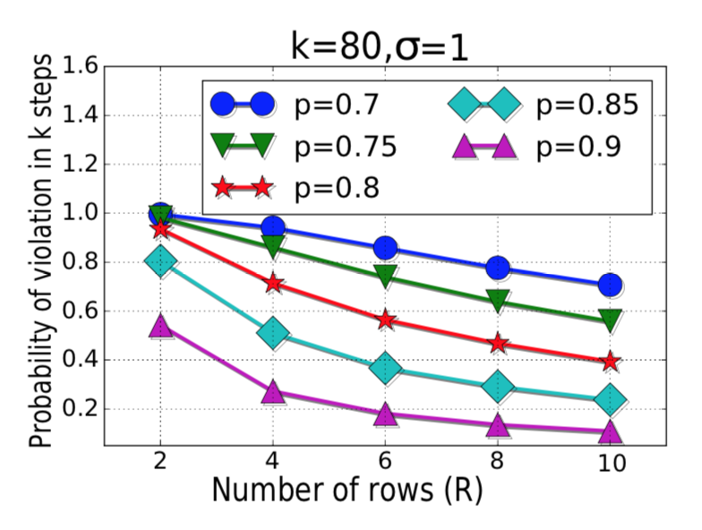
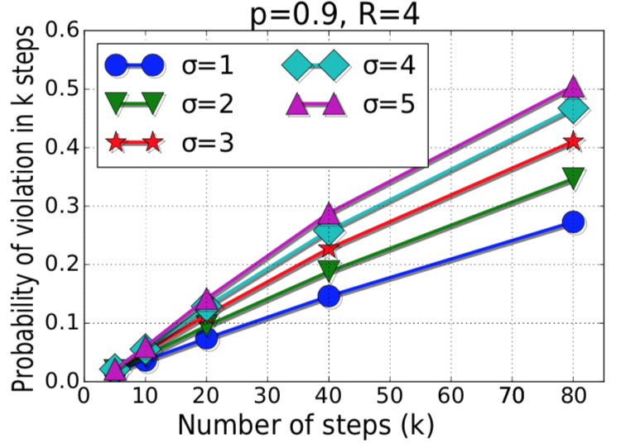
4
4
Distribution
(𝞼)
𝞼
Violation Probability (P_{vio})
R=3
2
3
3
# Steps (k)
p
p
5
1
1
Clust_Size: Choose R
Run_Length:Choose k
K=5
# Clusters (R)
As 𝞼 or k increases, P_{vio} increases.
As p or R increases, P_{vio} decreases.
18

Slide 19
Split-Merge
Split: Choose R
R: Number of clusters initially
L: Request rate
Min R’
R’ > R
L/R’ < 𝞽
P_{vio} < P
R' < R_{max}
R’: Number of clusters after split
𝞽: User defined threshold
P: User defined bound on violation probability
19

Slide 20
Evaluation
Theoretical Model
Consistency Spectrum
Existing Solutions
Overloading

Slide 21
Over open source Cassandra.
Posts stored as key-value pairs. (Similar to Facebook)
GLEE (Good quaLity Experience and pErformance).
GLEE
Social Consistency
Replication Factor: 1 Consistency Value: 1
Replication Factor: 1 Consistency Value: 1
Cassandra
Replication Factor: +1 Consistency Value: 1
Eventual Consistency
21

Slide 22
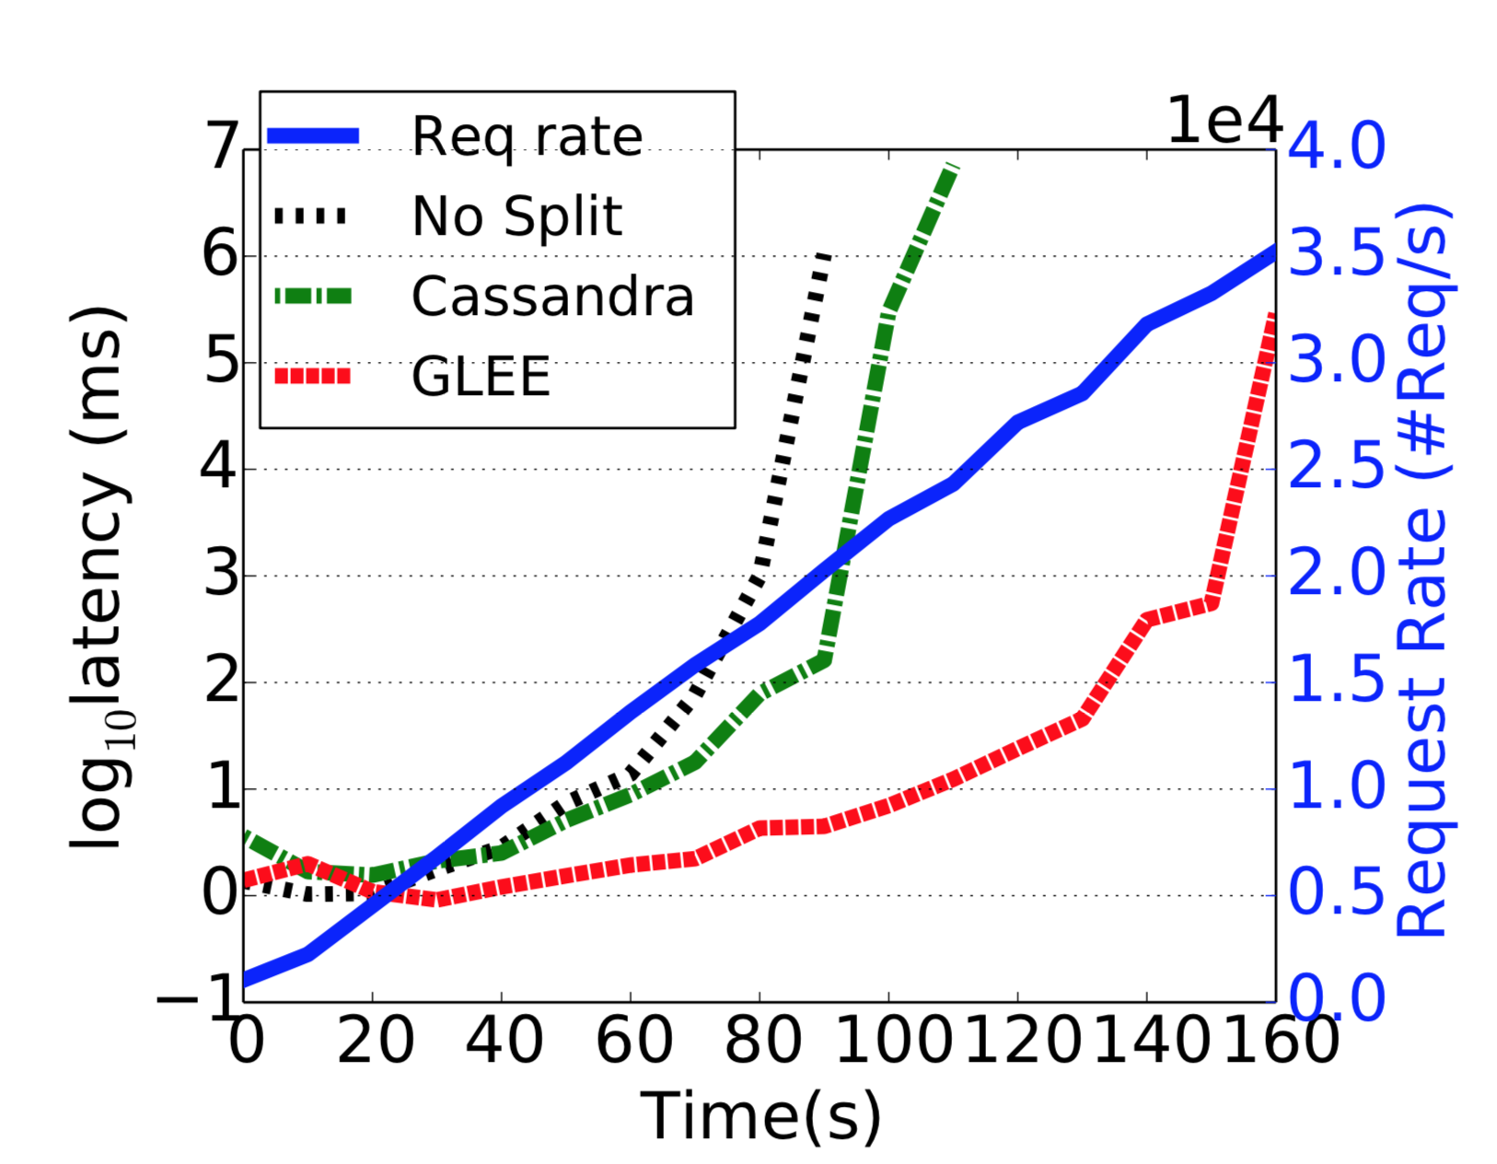
1.6X No Split
1.5X Cassandra
Mixed Workload
22

Slide 23
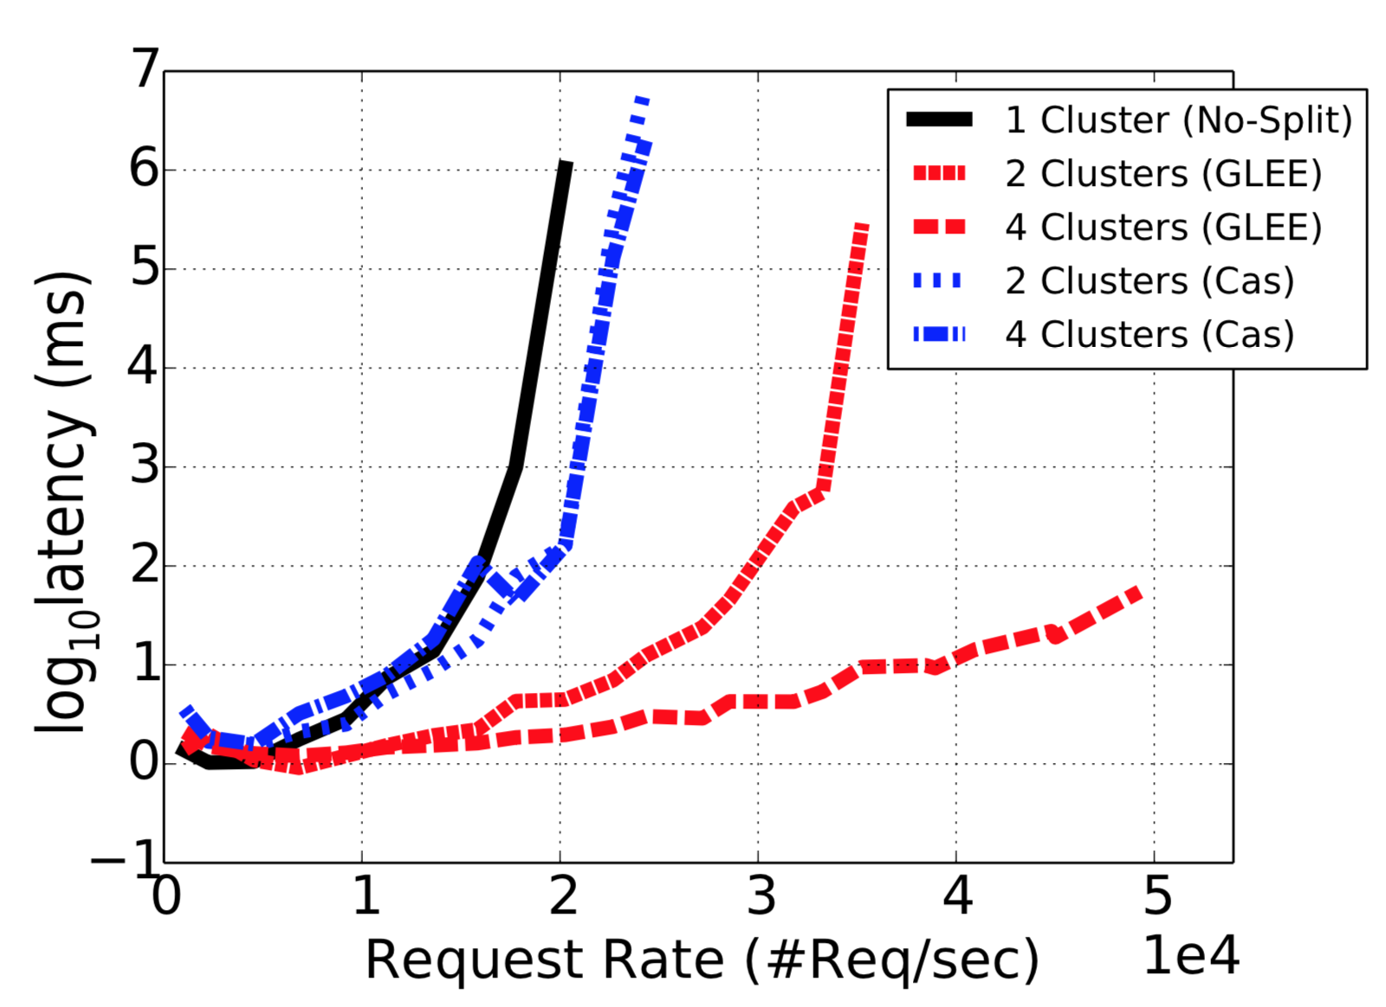
2.4X No Split
2.4X Cassandra
Multi-Split Workload
23

Slide 24
Evaluation
Theoretical Model
Consistency Spectrum
Existing Solutions
Overloading

Slide 25
Summary
Proposed a model for analysing a system with multiple SC sub-domains.
2
Used it to implement a novel social consistency model.
4
Compared against Cassandra. Outperforms by handling 1.6X - 2.4X more workload.
3
Evaluated on synthetic and real-world datasets.
1
25

Slide 26

26

Slide 27
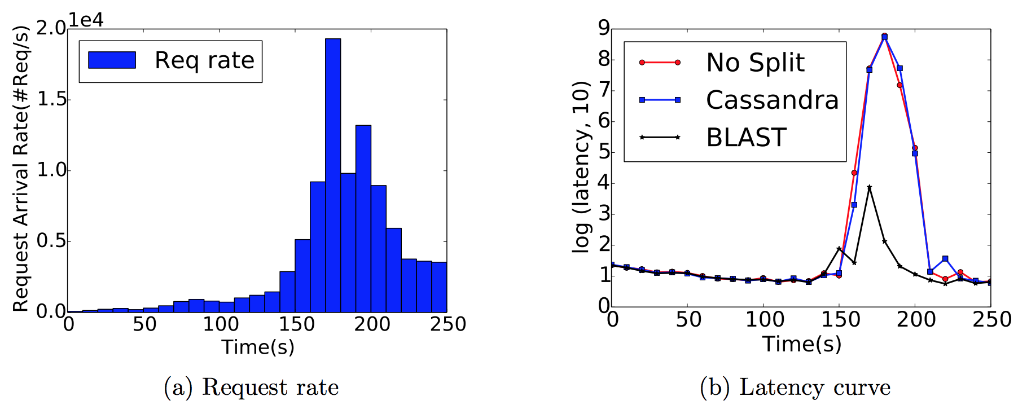
Twitter DataSet
Req Rate increased from 9000 req/s to 18000 req/s.

Slide 28
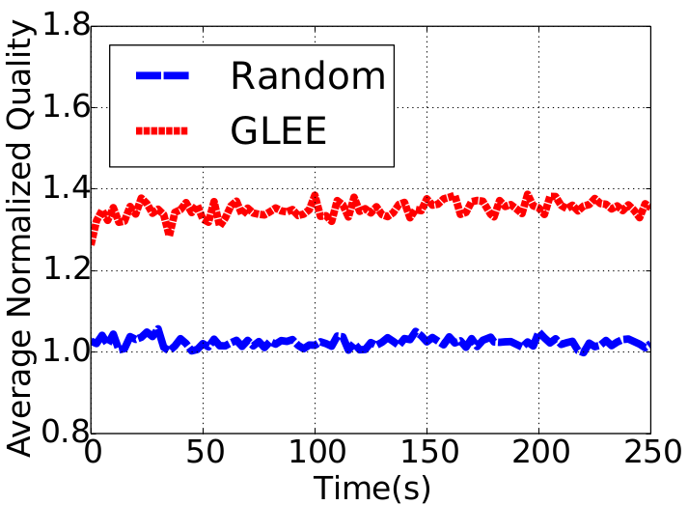
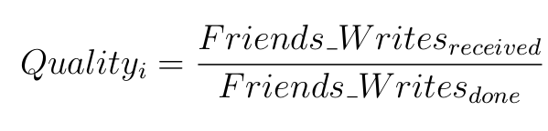
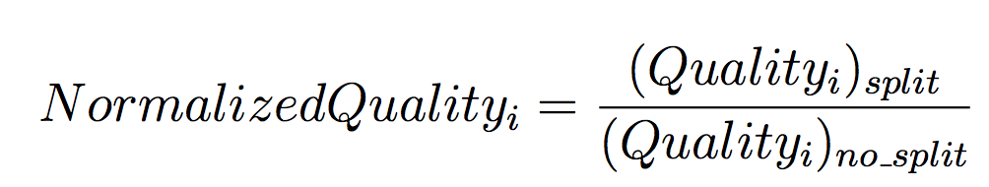
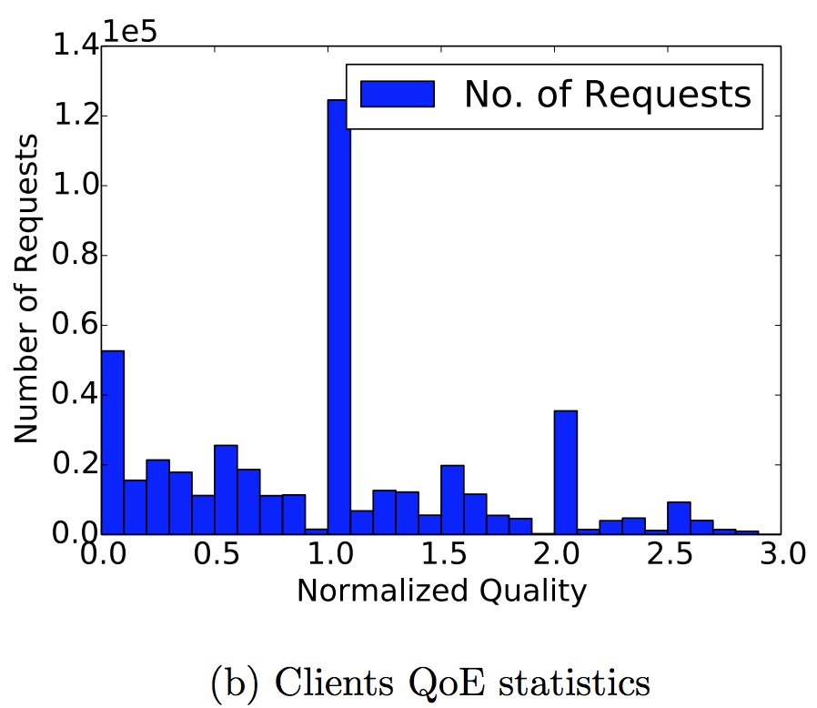
Quality of Experience (QoE)
Quality of response is high, if it contains all the previous writes by user’s social connection.
Twitter dataset.
Average quality 1.37X
30% requests have quality reduction of 50%
Implemented ‘Random’ model [ENTZ, RLB].
Clients do not interact.
Random Partitioning.

Slide 29
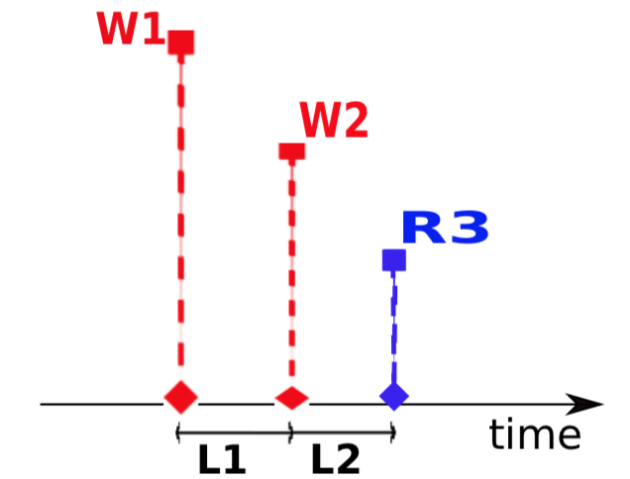
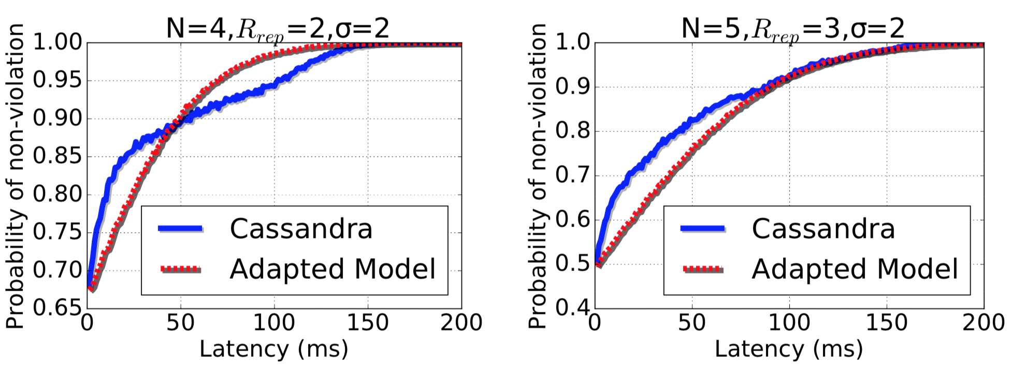
Empirical Validation of our model
Our formulation Adapted to model Cassandra

Slide 30
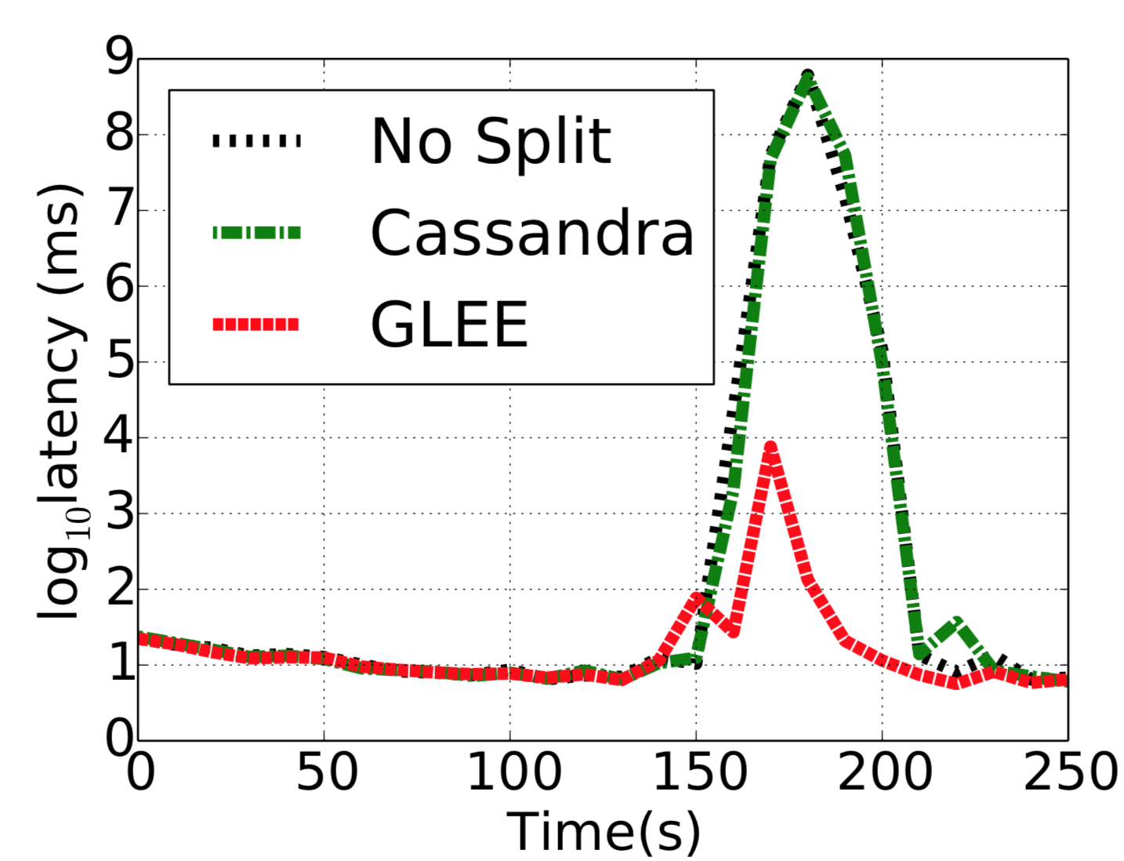
Twitter DataSet
Mixed
1.6X No Split
1.5X Cassandra
Multi-Split
2.4X No Split
2.4X Cassandra

